Slide 1


DSO528 Blended Data Business Analytics for Efficient Decisions
More on Clustering
Feng Chen

Slide 2
Learning Objectives
Recognize the importance of selecting an appropriate number of clusters.
Perform Silhouette analysis on K-means clustering.
Analyze the visuals from the Silhouette analysis and make a recommendation on the optimal number of clusters.
Compare clusters formed using different values of K (number of clusters), identify the key differences, and propose the most suitable K based on the business context.

Slide 3
How do we choose the right number of clusters?
How do we decide “best”?
Silhouette analysis
Cubic Clustering Criterion (CCC)
“Elbow criteria”
Plot total sum of square errors as a function of k
Choose the point where the plot has a kink or “elbow”
The most important criteria: business application

Slide 4
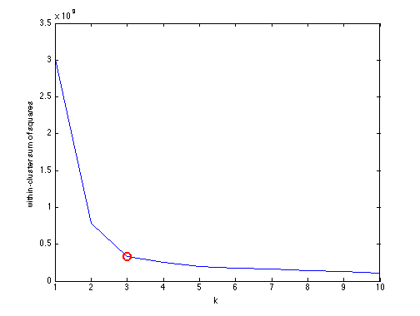
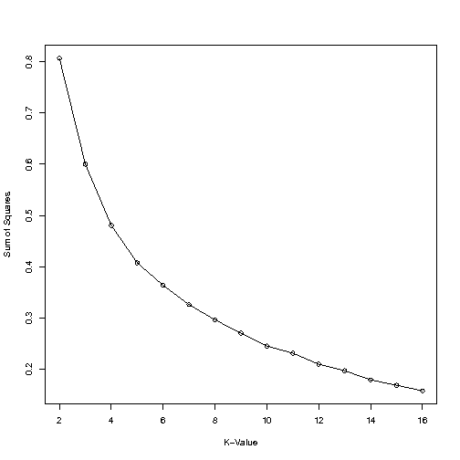
Elbow method in practice…
Theory
Practice
After the elbow, very little reduction in Total sum of Squares

Slide 5
Choosing number of clusters
Again, I argue a better approach is to think about the application
Interpret the clusters
Provide an intuitive explanation of each cluster
Choose the number based on what’s appropriate to the business application

Slide 6
Silhouette analysis
Proposed by Belgian statistician Peter Rousseeuw in 1987
A technique used to evaluate the quality of clustering by measuring how similar each point is to its own cluster (cohesion) compared to other clusters (separation).
Helps determine number of clusters (K) to apply.
Each data point has its Silhouette coefficient
Silhouette value ranges from -1 to +1
High value indicates data point well matched to its own cluster.
Value of 0 denotes that the data point is close to the boundary between two clusters.
Negative value means that the data point is assigned to the wrong cluster.

Slide 7
Silhouette value of a single data point
The silhouette value combines information about both the cohesion and separation of the data point
Cohesion measures the similarity of the data point in the same cluster
Separation measures the dissimilarity of the data point and other clusters
For a data point
Silhouette value = (Separation - Cohesion) / Max (Separation, Cohesion)

Slide 8
Silhouette coefficient for clusters
Overall average silhouette values for a clustering
Over 0.7, considered ”strong”
Over 0.5, considered “reasonable”
Over 0.25, considered “poor”
In general, values decrease with increasing number of features applied in clustering
May not perform well
Again, it is more important to consider the business application!

Slide 9
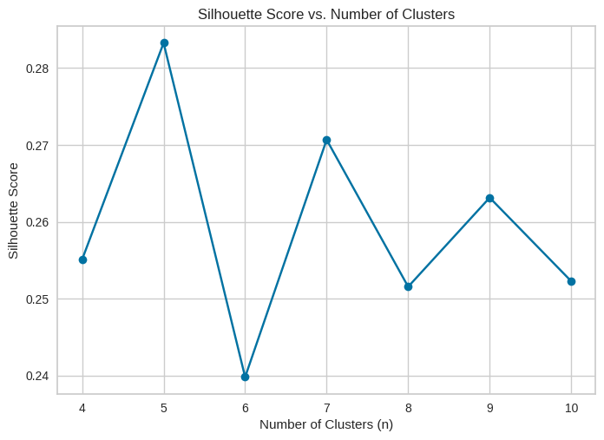
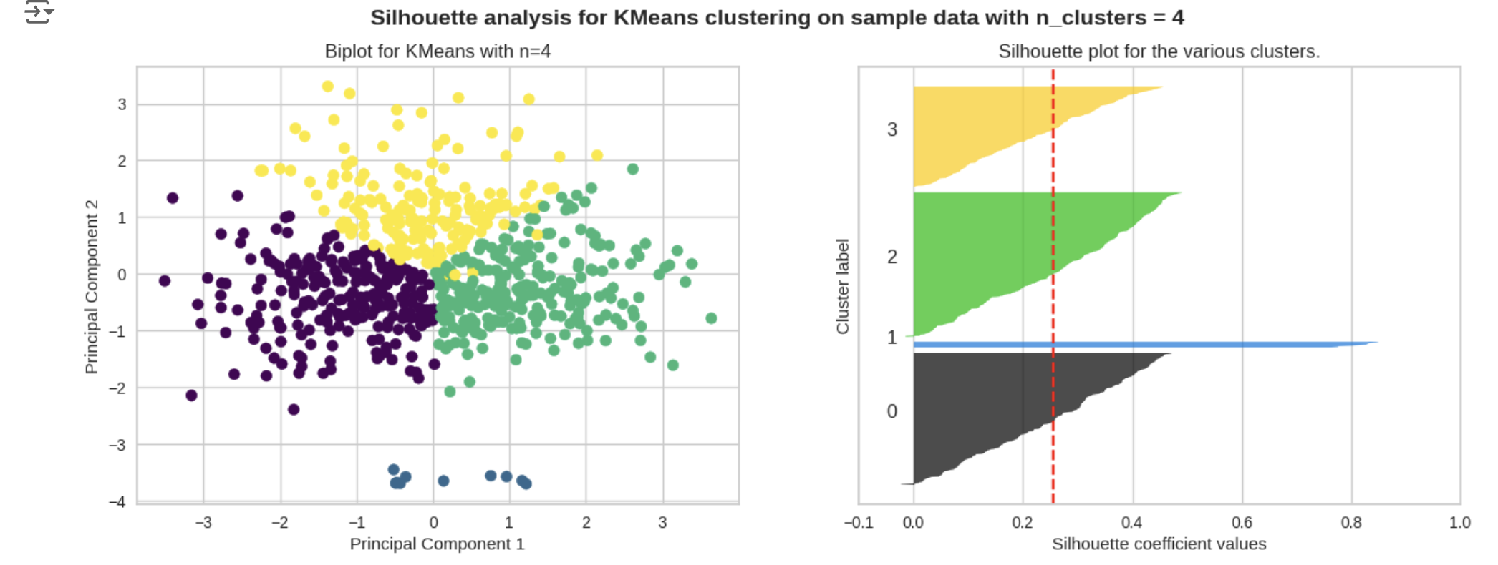
Visuals in silhouette analysis

Slide 10

Wrapping up
Recognize the importance of selecting an appropriate number of clusters.
Perform Silhouette analysis on K-means clustering.
Analyze the visuals from the Silhouette analysis and make a recommendation on the optimal number of clusters.
Compare clusters formed using different values of K (number of clusters), identify the key differences, and propose the most suitable K based on the business context.

